Slide 1
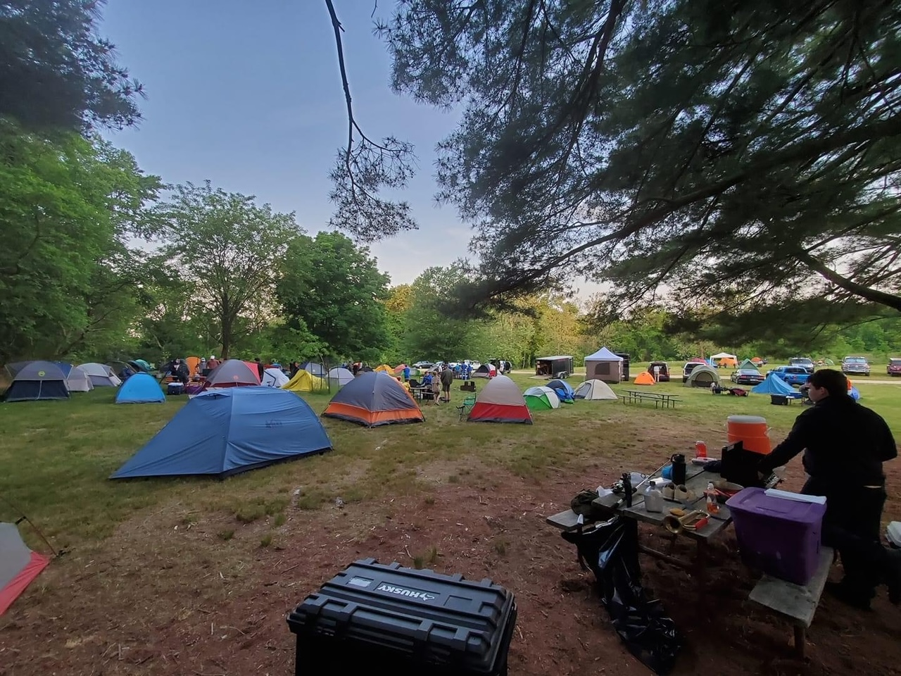
Scouts BSA
New Scout Parent Orientation
Spring 2022
Troop 313 | Harford District | Baltimore Area Council

Slide 2
Included in Presentation
What Scouting is All About
Troop Organization
  Goals (Aims), Troop 313, Key 3
Scout’s Leadership within the Troop
Safety First!
Troop Camping
Equipment
Uniforms
Advancements
Service Project
Troop Communication
Budget & Finance
Health & Wellness
How to Help!
Q&A

Slide 3
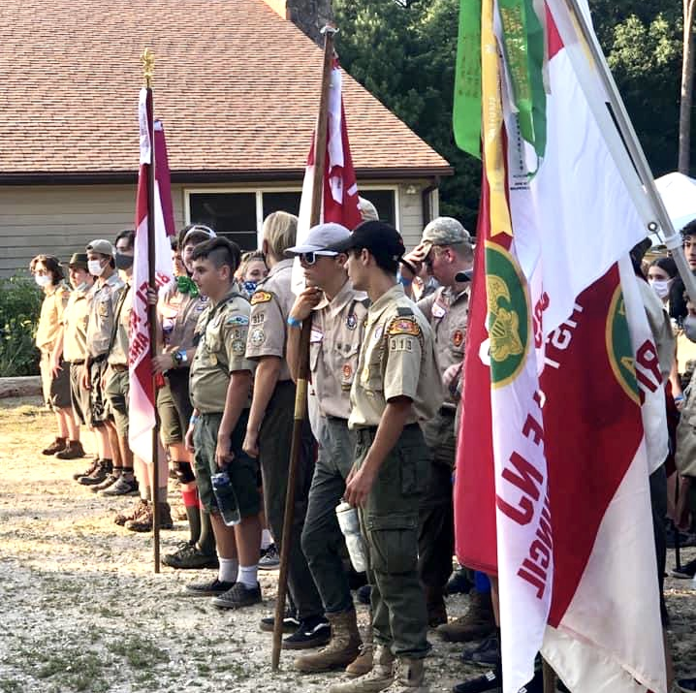
What Scouting is All About
Scouts BSA is the traditional Scouting experience for youth in
fifth grade through high school.
Service, community engagement, and leadership development become increasingly important parts of the program as youth lead their own activities and work their way toward earning Scouting’s highest rank, Eagle Scout.

Slide 4
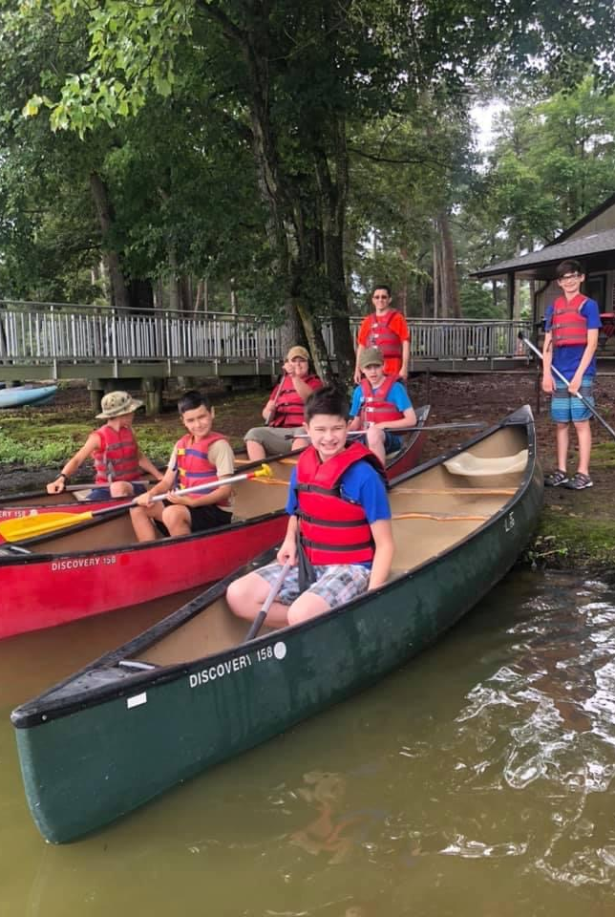
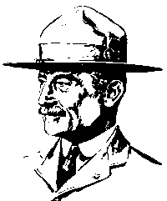

The Goals of Scouting
The Aims of Scouting BSA
  Character development
  Citizenship training
  Physical, mental, and emotional fitness
Aims Are Delivered by These Methods
  Patrols
  Outdoor Programs
  Advancement
  Personal Growth
  Leadership Development
  Uniform
  Associations With Adults

Slide 5
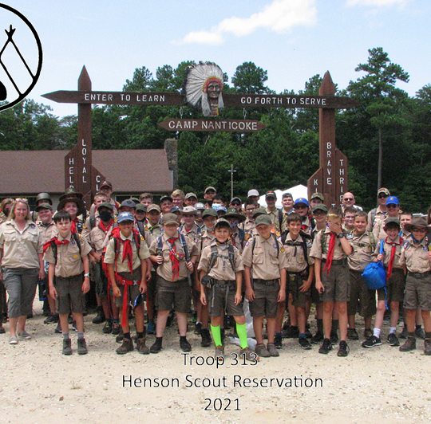
Troop 313
First chartered in 1927
Today we have over 70 Scouts of a variety of ages and ranks, with over 50 attending Summer Camp.
Currently we have about 7 patrols and 1 Cyber patrol which are diverse in age and rank.
So far in 2022, we had
1 scout earn Eagle Rank and 5 scouts working on proposals.

Slide 6
Key Three
  Alan Cushen
  Andy Whaley
  atwhaley@gmail.com
  Debbie Welch
  debbiewelchyoga@gmail.com
  Chartered Organization Representative
  Scout Master
  Committee Chair
  The COR is the direct contact between the unit and the Chartered Organization. This individual is also the organization’s contact with the District Committee and the Local Council.
  The SM is the adult responsible for working directly with the Scouts to help them create the program for the troop.
  The SM trains scout leaders to run the troop by providing direction, coaching, and support.
  The CC’s primary responsibility is to organize adult volunteers so that they handle troop administration to support troop leaders in delivering a quality program.

Slide 7





Scout’s Leadership Within a Troop
Patrols
Troop Youth Leaders
A Troop is made up of scouts in patrols
A patrol is a small group of scouts within a troop. They elect a patrol leader and function almost like a family within the troop. They divide up the duties to be done and work together as a group to meet their goals. They develop a patrol spirit and take pride in their accomplishments as a team.
  The Troop is run by its scout leaders, guided by adults (Scoutmaster & ASMs)
  Senior Patrol Leader (SPL): Leads the Assistant Patrol leader, patrol leaders and Troop Guide, in consultation with the Scoutmaster, appoints other junior leaders and assigns specific responsibilities as needed.
  Assistant Senior Patrol Leader (ASPL): Fills in for senior patrol leader in an absence. ASPL is also responsible for training and giving direction to the: quartermaster, scribe, troop historian, librarian, and instructors.

Slide 8


Scout’s Leadership (continued)
Leadership Roles
Troop Elections usually held twice a year, typically in March and September
      Senior Patrol Leader (voted on by Troop)
      Assistant Senior Patrol Leaders (appointed by SPL)
      Troop Guide (appointed by SPL and SM)
      Troop votes on other positions (scribe, QM, historian, etc.)
      Patrols elect their Patrol Leaders and Assistant Patrol Leaders

Slide 9
Troop and Scout Communication
Troop Chain of Command
Scoutbook http://www.scoutbook.com
  Check Troop Website on how to make sure your Scout’s email is added.
Facebook
Troop Website https://www.troop313harford.com/
Baltimore Area Council https://www.baltimorebsa.org/
BSA
https://www.scouting.org
  Scout  Patrol Leader
  Patrol Leader  Senior Patrol Leader
  Senior Patrol Leader  Scoutmaster
  Scoutmaster  Committee Chair & Assistant Scoutmasters
  Committee Chair  Committee & Parents
  And reverse!

Slide 10
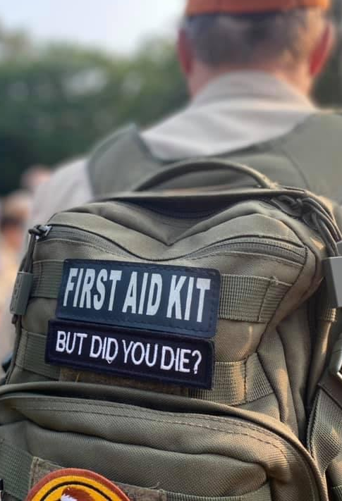



Safety First!
YPT (Youth Protection Training)
Medical Paperwork
Trip Planning
2 Deep Leadership
Training and Preparation
ALL ADULTS! Intervene if you see a safety issue that could harm the Scout and others!

Slide 11
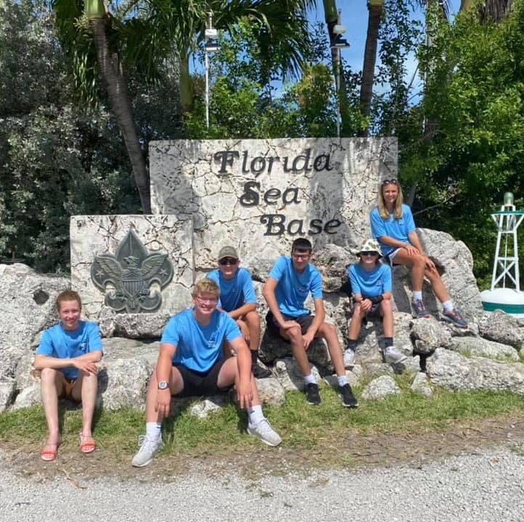
Troop Camping
Camps and Campouts
  Troop 313 camps an average of once each month
  Summer Camp every summer
  High-Adventure Trips
      Philmont (New Mexico)
      Sea Base (Florida)
      Northern Tier
      (Canada & Minnesota)
      Bechtel Summit (West Virginia)
    Regional High Adventure Trips

Slide 12
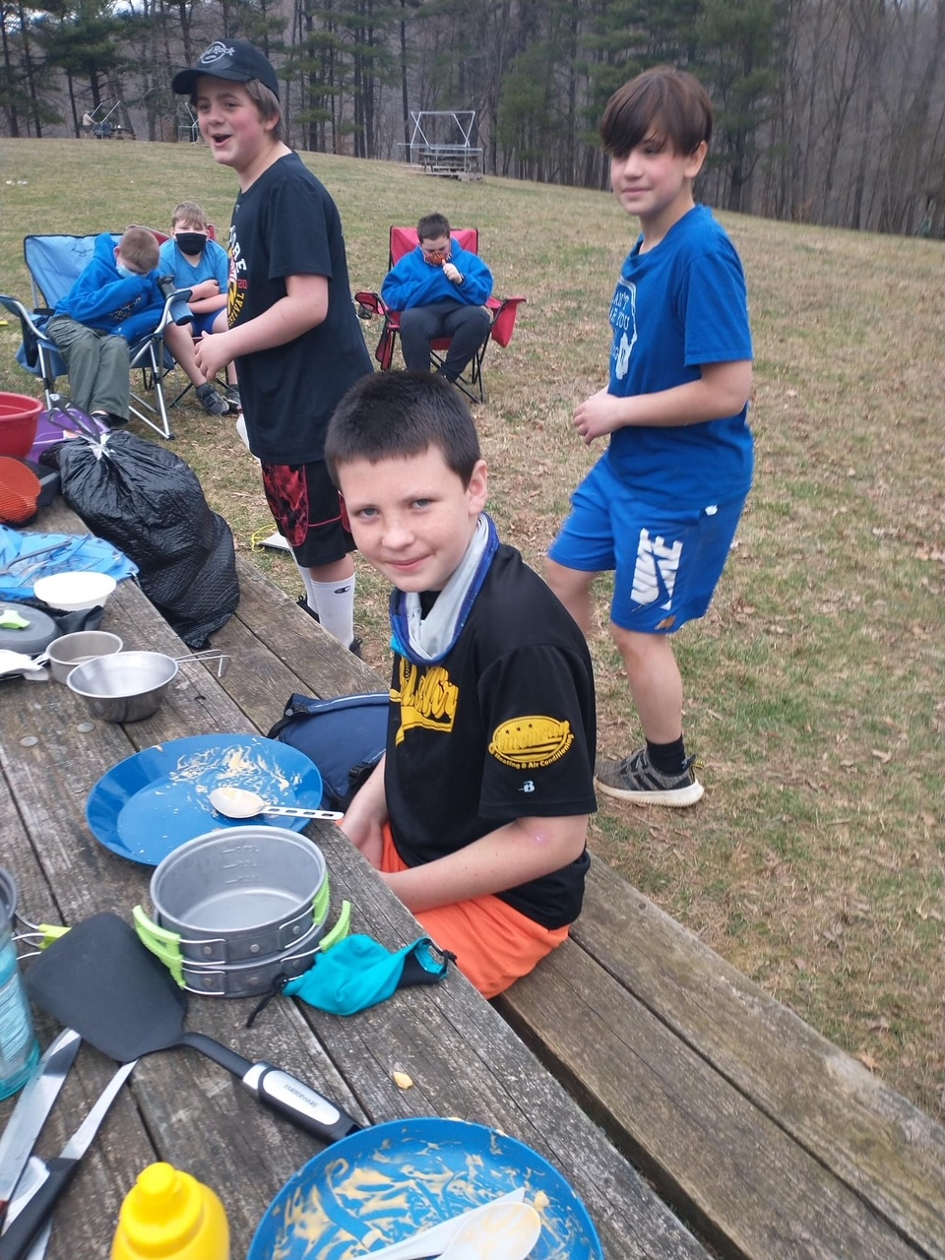
Regular Campout Procedures
      Annual planning & scheduling meetings
      Monthly planning at PLC and Troop Meetings
      Patrols plan, purchase, and cook their own meals
      Scouts determine menu, baking, and duty roster
      on the Wednesday prior to trip
      Transportation is arranged prior to the trip
      Most trips leave Christ Our King on Fridays around 5:30pm and return to COK Sunday mid-morning

Slide 13

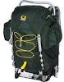
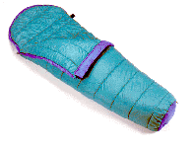
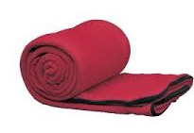
Recommended Equipment
  Tent
    With seam sealer, waterproofed,
    switch out to better stakes
  Backpack or Dufflebag
  Sleeping Bag and Pad (weather related)
  Mess Kit (with fork, knife, spoon, plate, cup, and bowl)
  Scout Book
  Camp Chair
  Essentials
    Pocket Knife or Multitool (w/Totin’ Chip)
    First-Aid Kit
    Extra Clothes
    Rain Gear
    Trail Food (only if sealed)
    Water
    Matches and/or Fire Starter
    Sun Protection
    Map and Compass
    Whistle
    Flashlight/Headlamp (extra batteries)

Slide 14
Uniforms
  Field Uniform (formerly Class A)
  Tan scout shirt, scout pants or shorts, scout belt, and scout socks (neckerchief given at Crossover)
  Required for Courts of Honor, Troop meetings, to camping trips, meals on some campouts, and other more formal events
  Activity Uniform (formerly Class B)
  Troop or other Scout t-shirt
  Worn during camping trips, service projects and other “activity” events
Other Information
Scout Shop or Order Online
Scout Closet: Used and outgrown uniforms

Slide 15
Rank Advancement Summary
4 Steps to Advancement
  A Scout Learns
  A Scout is Tested
  A Scout is Reviewed
  A Scout is Recognized
Scout advancement isn’t age or grade-based
  The Scout, on their own initiative, progress at
  their own pace
  Support and guidance from their parents and
  Scout leaders is critical
The Scout BSA Handbook contains all requirements and the signoff copy for all ranks
Alternative paths for advancement are available for scouts with disabilities

Slide 16
Recording of Advancements
Scout Handbook
Scout Book
To be recorded and approved by a
higher Ranked Scout
Scoutmaster and/or Assistant Scoutmaster
Board of Review (Committee Members)
Submitted to Advancement Chair for BOR
Scout’s Primary advancement record
Individual Rank Advancements may be input by individual scout
Rank approved by Advancement Chair after BOR
Merit Badge requirements may be recorded by scout if done individually; approved by the Advancement Chair/Assigned Counselor
If done as a group or troop event, must be recorded by Advancement Chair
Troop Camping and Service Logs are filled out by Advancement Chairs

Slide 17

A Scout Learns: Rank Advancement
Scout Rank: Learning the Basic Information
  Knowledge and understanding of the Scout Oath,
  Scout Law, Scout Motto, Scout Slogan, and troop operations and safety
  80% of requirements are similar to the Arrow of Light
  (Cub Scouts)
  Most scouts earn soon after joining (2-3 Months)
  Knowledge of how Merit Badges and the
  Troop operate

Slide 18
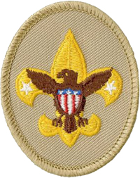
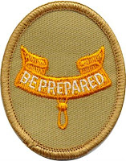

A Scout Learns: Rank Advancement
Tenderfoot, Second Class, and First Class: Oriented toward learning and practicing life and scout skills
  Key concepts: Camping, First Aid, Aquatics, Citizenship,
  Hiking, Land Navigation, and Fitness
  Requirements for community service for all ranks
  Many requirements teach techniques for life experiences and working towards Eagle
  Requirements can be worked, simultaneously; ranks earned
  in sequence
  No Time Requirements, a scout could complete a Board of Review for Tenderfoot and Second Class in the same night!
  Most Scouts can reach First Class in approximately 18 months

Slide 19
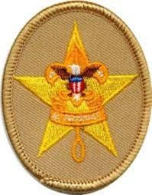
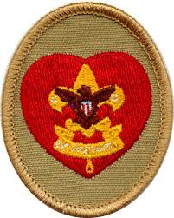

A Scout Learns: Rank Advancement
Star & Life Requirements (Mastering the Scout Skills)
  5-6 Merit badges (some Eagle Required)
  4-6 Months of Leadership
  4-6 Months time in rank
  Community Service
Eagle Scout Requirements
  21 Merit badges (13 Eagle Required in July 2022)
  6 Months of Leadership & time in Rank
  Community Service Project (Plan, Fundraise, Execute)
  Complete a District Level Board of Review

Slide 20
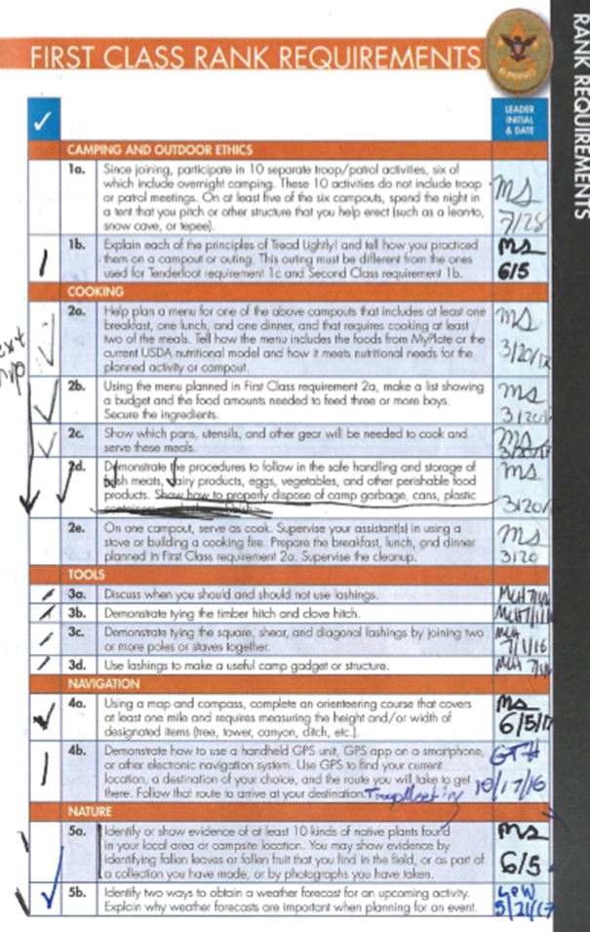
A Scout is Tested
In Troop 313, Scouts two ranks higher may approve a
Rank Achievement. (Example: 1st Class can test Tenderfoot, Star can test 2nd Class, and Life can test 1st Class. Adults test Star, Life, and Eagle.)
Those approving must witness or test the Scout as stated in the book
  If, for example, a requirement uses words like “show,” “demonstrate,” or “discuss,” then that is what Scouts must do. Filling out a worksheet, for example, would not suffice.

Slide 21
Rank Advancement . . . Pitfalls
Pitfalls exist for all scouts and increase as they get older
  Lack of getting items signed off
    Must repeat requirements
    Lose interest
    Lack of participation
  Lost Records
    Missing Rank Cards
    Missing Merit Badge
    Lost Scout Handbook
  The “Fumes”
  Poor planning
    Not enough time for ranks
    Not able to complete merit badges
      Personal Management, Family Life, and Physical Fitness all have
      3-month logging requirements
      Camping MB requires 20 nights
      Some MBs have prerequisites (Emergency Prep requires First Aid)

Slide 22
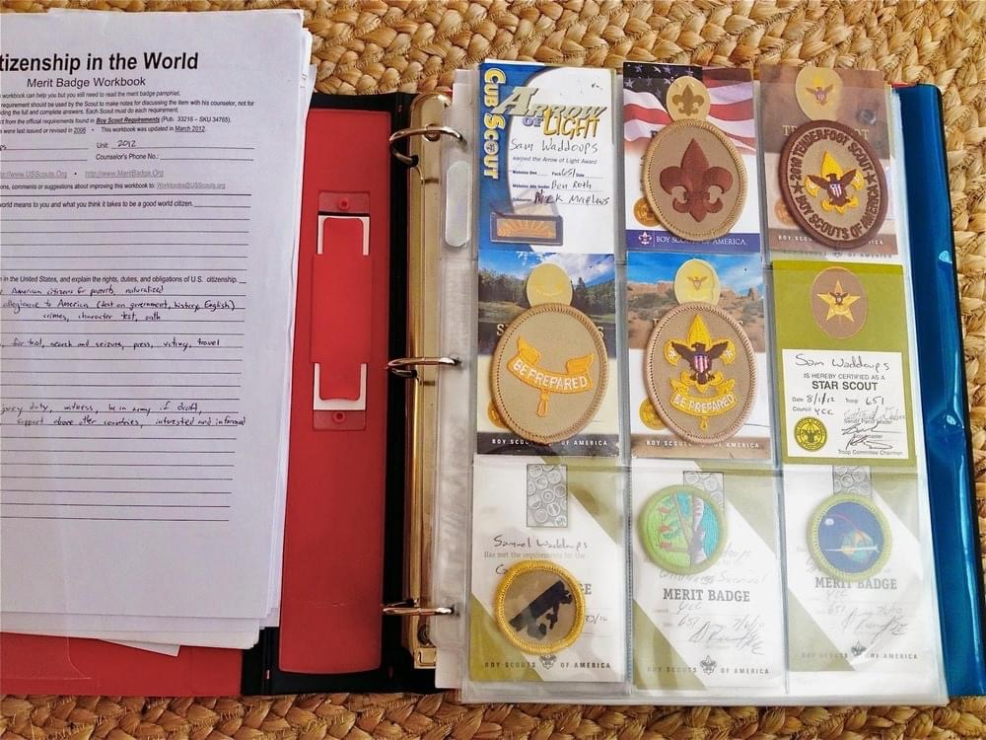
How to Avoid the Pitfalls
Start on the Eagle Binder with all rank and
MB Cards in 9 pocket holders
Make copies of scout handbook approvals periodically, put into Eagle Binder
Most important . . . Be involved with your scout, ask questions, ask where you can help and motivate through the tough times

Slide 23
Rank Advancement: Parents’ Role
Parents’ role is to monitor, motivate, and support the scout
  Establish joint plan to work to Eagle Scout rank with time frames
  (set reasonable timeframes) ** Include time for other activities
  Sit down and review your scout’s rank progress on a regular basis
  Ask what skills they are learning, working on in their book, ask what they got signed off this week or month
  Incorporate skills into daily life: cooking, citizenship, first aid, and physical fitness
  Ask about what merit badges are interesting to them
  See where they are having roadblocks and ask how they can work through them
  Encourage the scout meet with others and have items signed off when they know the skills and have completed the requirements

Slide 24
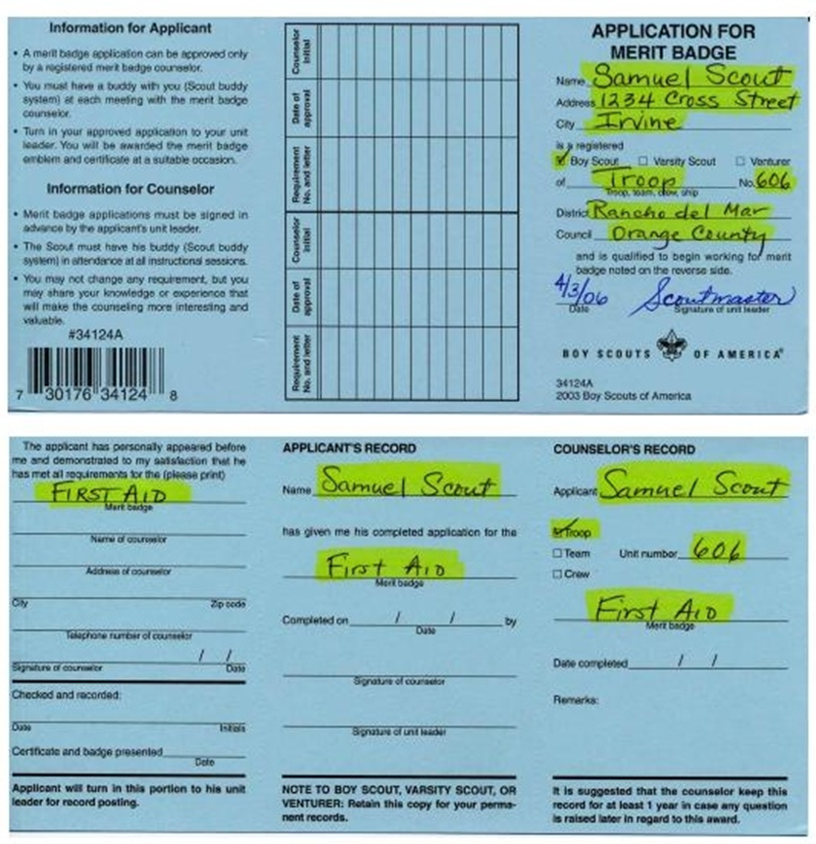
A Scout Learns: Merit Badges
The Recommended Merit Badge Process
  Scout develops an interest in a merit badge; may begin working on the requirements
  Scout discusses interest in the merit badge with his unit leader (Scoutmaster or designee)
  Unit leader signs a blue card and provides the Scout
  with at least one counselor contact
  Scout contacts the counselor. Merit Badge Counselors
  must be BSA Registered, Council approved, and must
  have completed Youth Protection training within the last two years
  Counselor considers any work toward requirements completed prior to the initial discussion with the unit leader

Slide 25
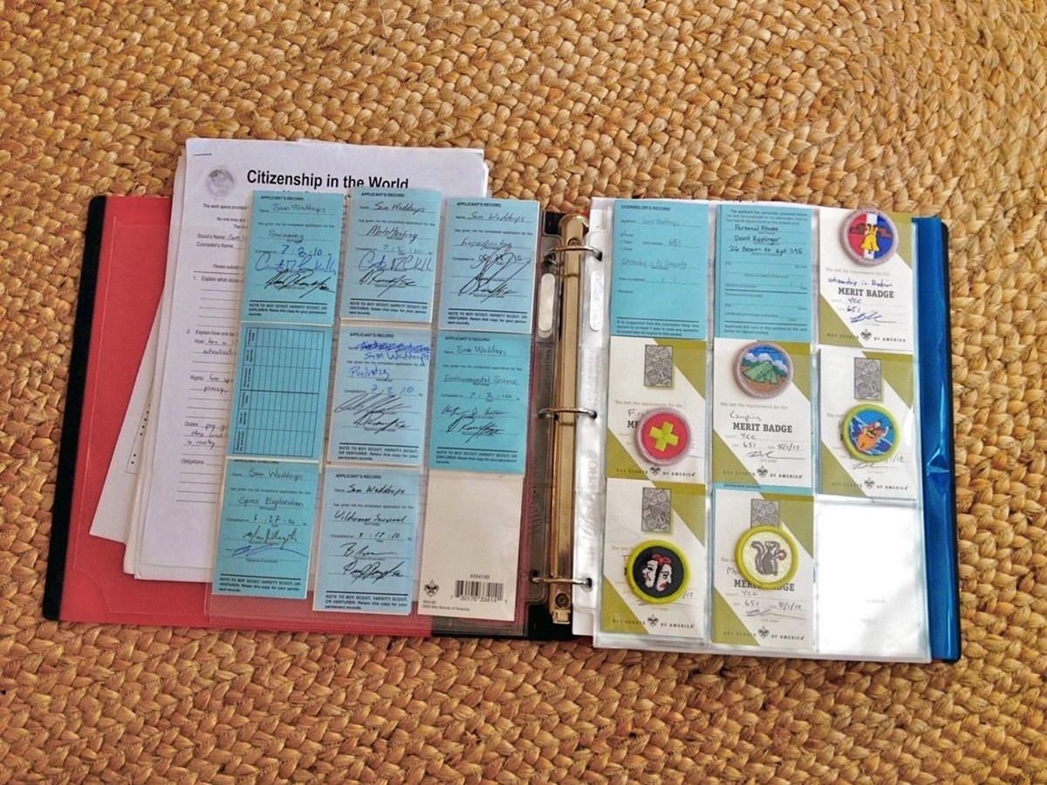
A Scout Learns: Merit Badges (continued)
  Scout must meet the requirements as stated in the merit badge book. No more, no less
  Scout, his buddy and the counselor meet
  (often several times)
  Scout finishes the requirements
  Counselor approves completion via the Blue Card and returns 2/3 of blue card
  Scout gives the blue card to Advancement Chair
  Advancement Chair reports the merit badge to
  the council
  The Scout receives his merit badge, and the applicant record of blue card at the Court of Honor

Slide 26
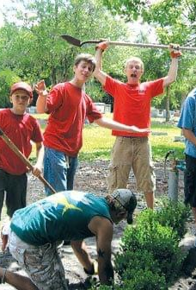
Service Projects
  All Scouts are expected to participate in service projects. The purpose of this activity is to build a sense of community
    “Leave this world a little better than you found it.” - Lord Baden-Powell
  The Troop will participate in various service projects, for example: Scouting for Food, Second Saturday at Christ Our King
    Service projects include Eagle projects for Scouts in our Troop
  Required for some Merit Badges

Slide 27
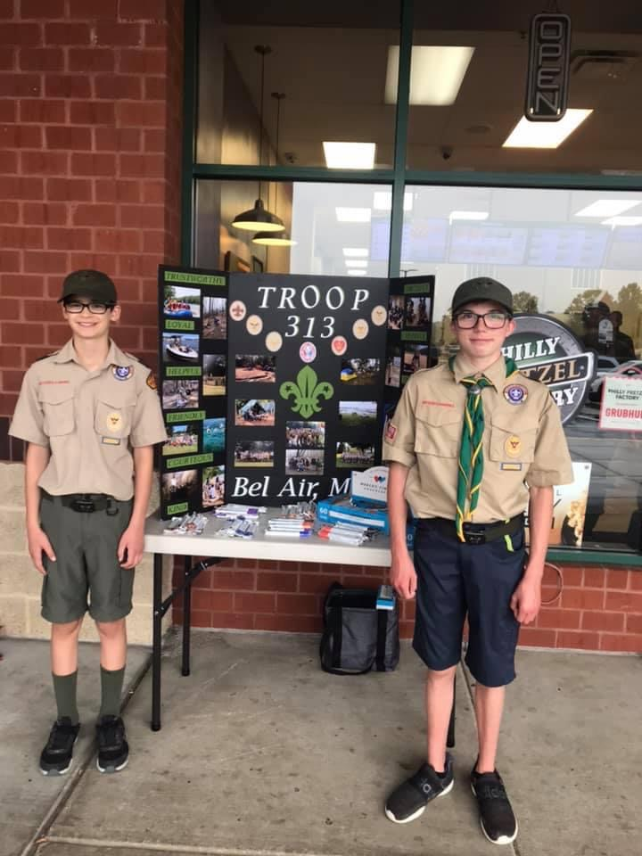
Budget and Finance
Major Fundraisers
  Performed by entire Troop
  Under Development, as needed
Activity Fees (usually $20 per trip) are paid via Square
Troop Budget
  Troop Equipment
  Patches and Awards
  Ceremonies, Events
  Scout needs

Slide 28
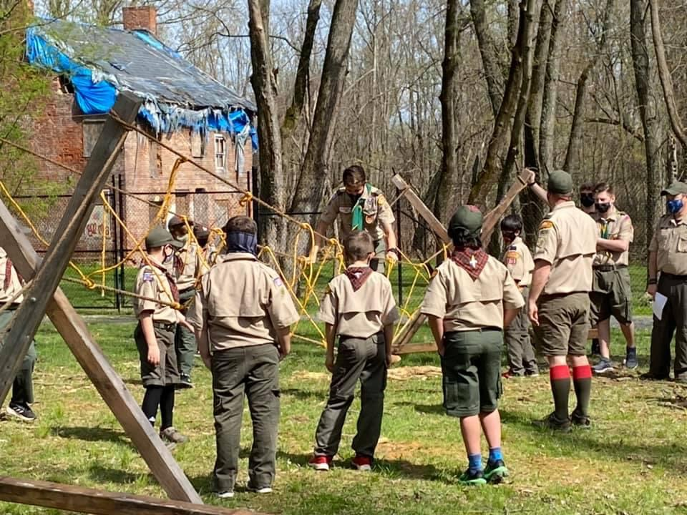
Annual Re-Chartering Fees
BSA grants Christ Our King a charter to run
Troop 313. We collect rechartering fees in the fall for returning scouts.
Fees
  New / Renewal Scout: $160
  Crossover Scout (Webelos!): $60
  Adult Registration: We charge what BSA charges

Slide 29
What Troop 313 Needs from YOU!
Scouts
  When joining/transferring
    BSA Scout registration form
    Contact information &
    Medical form
  Dues
    New Scout $160.00
    Crossover Scouts $60.00
  Update every year
    Medical Form, dues, contact information (as needed)
Registered Adult Leaders
  Same Information as scouts, plus YPT
  Dues – BSA rate

Slide 30

Health and Wellness
  Medicine Handling
  Scout must administer own medicine unless specific
  circumstances prevent it
  Medical Forms
  Forms A&B for 2 or less days (weekend trips)
  Forms C required for 3-day trips or longer (physician filled in form)
  Special Needs/Disabilities
  Any special needs or disabilities should be discussed with the Scoutmaster and/or Committee Chair
  This is a judgement free zone
  Knowing helps Leaders and helps Scouts

Slide 31
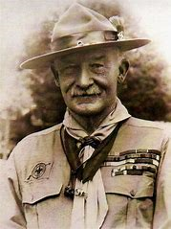
How to Help
Volunteer for one of the Adult Roles
  Merit Badge Counselors
  Assistant for Trips or Activity
  General Committee Members
  Transportation
  Fund Raiser Support
  Service Support
“When you want a thing done, ‘Don’t do it yourself’ is a good motto for Scoutmasters.

Slide 32
Troop 313 Committee
Debbie Welch: Committee Chair
Ryan Gross: Advancement
Chris Van de Verg: Treasurer
Ashley Matiello: Fundraising Coordinator
Joe Rainwater: Summer Camp Coordinator
Matt Cornelius: Equipment Coordinator
Alan Clayton: Webmaster
Chris Gauthier: Membership
Cheryl Wyngarden: Medical Officer
Mike Mullis: Chaplain
VACANT– Friends of Scouting
VACANT – Scouting for Food
VACANT – Parent Coordinator
VACANT – Public Relations
VACANT – Activities Coordinator (Usually ASM)
VACANT – Popcorn Fundraising
VACANT – Uniform Exchange/Lost & Found
VACANT – Troop Secretary
VACANT – Training Coordinator
See additional website for roles and descriptions

Slide 33
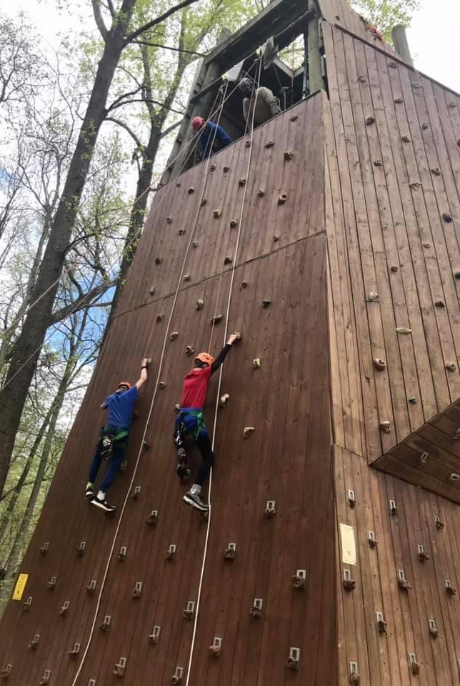
Adult Training Opportunities
  Position Training
  Wood Badge every Spring and Fall
  University of Scouting
  Introduction to Outdoor Leader Skills
  Eagles Nest
  Powderhorn
  Youth Protection Training Online
  Committee Training Online
  Round Table
  And many more

Slide 34
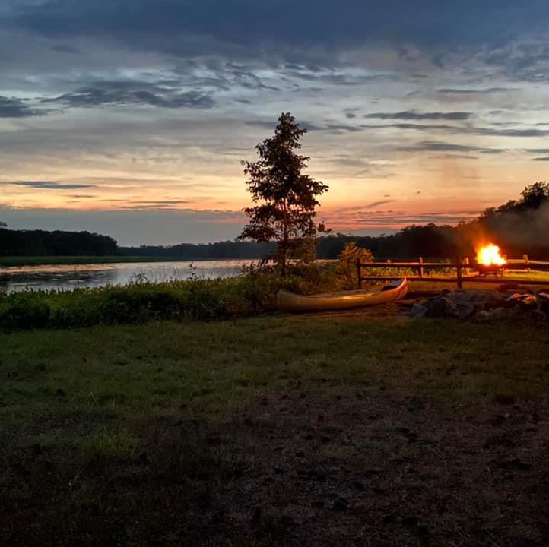
Questions?
“No one can pass through life, any more than he can pass through a bit of country, without leaving tracks behind, and those tracks may often be helpful to those coming after him in finding their way.”
-Robert Baden-Powell

